Slide 1
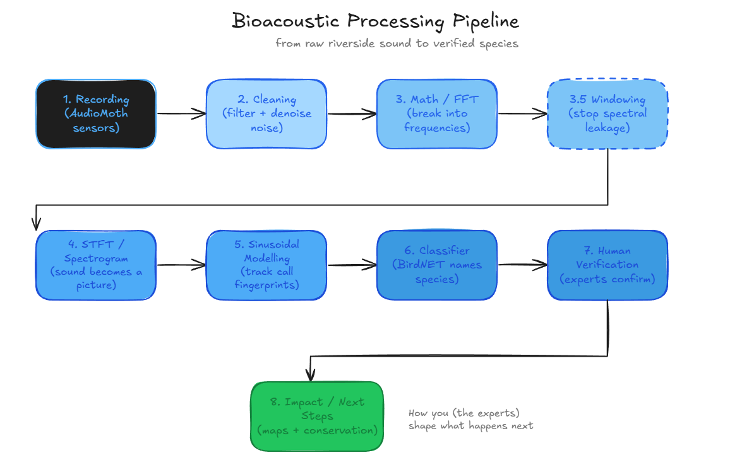
What Is The Problem? + Pipeline Overview
"What if there's bird species that are living in the riverside, that we do not know about ?"
Autonomous recording units (ARU) in the riverside capture enormous amounts of data, composed of environmental sounds, bird calls, human activity, and traffic.
Capturing data is the easy part processing it, is another hurdle.

Slide 2
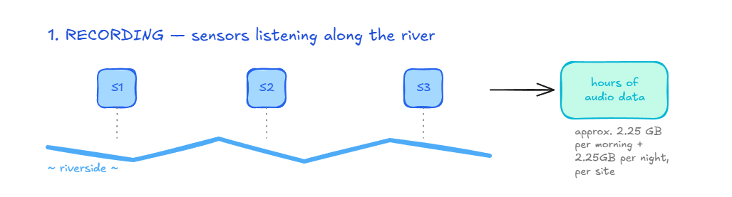
The Recording Process
Audio moth recorders capture 14 hours (7+7) of continuous bird data along the riverside, capturing up to 24Khz and sampling at 48Khz, including noises from riverside, traffic, human activity, or even other animals which may camouflage the sound we need.
It processes thousands of hours of audio data which would take incredible amounts of time for us humans to process, hence why an automated pipeline is crucial to make the finding of bird species feasible.
One 7-hour morning recording is 2.3GB of data, most data scaling up to 20-33 GB+ per week, per site; data across all 10 sites adding up to 200-330 GB+ per week, making it extremely difficult for humans to analyse and identify each bird
To capture sound reliably we must sample it at least twice as fast as the highest bird frequency, if we sample too slow we get aliasing which gives the same effect of seeing mirages/after-images of birds flapping their wings; to avoid that we use Nyquist's theorem.

Slide 3
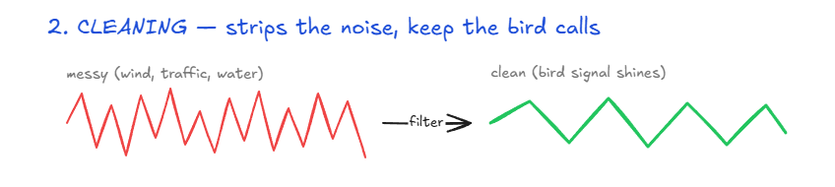
Audio Cleaning (Filtering+ Denoising)
Before we do any processing work, we must clean the recording from everything that obfuscates bird frequencies; especially at low frequencies as human activity, wind, riverside rushing water, and other factors affect the quality of results.
Research on riverside sites in Italy have shown that close traffic and river noise masks crucial bird activity especially at low frequency)
To tackle this, we use 2 techniques band-pass filters and wavelet denoising, to diminish the unwanted sounds.
Band-pass filter allows only specific ranges of bird frequencies through while cutting the frequencies above and below that range
Wavelet denoising allows high-frequency bird sounds to shine through, while ensuring environmental noise does not diminish/drown out the signal for us or the computer machines (this is a mandatory pre-processing step, if the audio remains uncleaned the automated "birdwatcher" has no direction; running blind)
Wavelet denoise can also persevere structured low-frequency calls (e.g. owl), while still removing low-frequency environmental noise (e.g. wind), as it separates sounds by their structure across various levels and not just the frequency they are in.

Slide 4
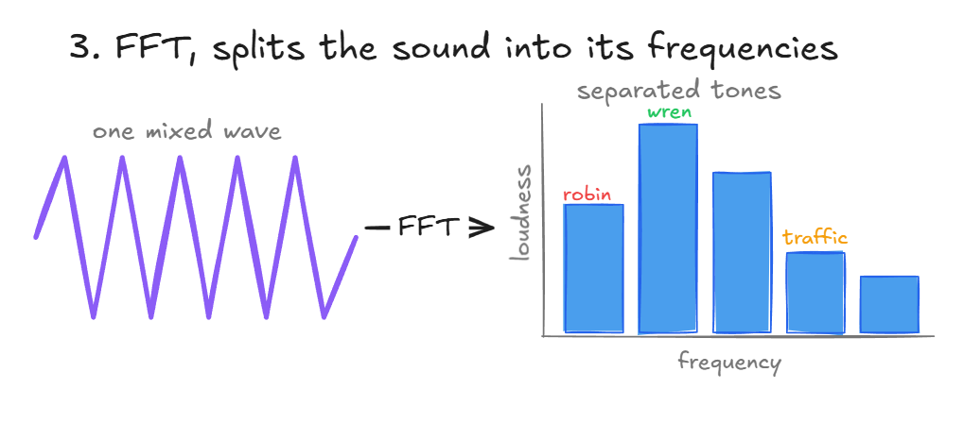
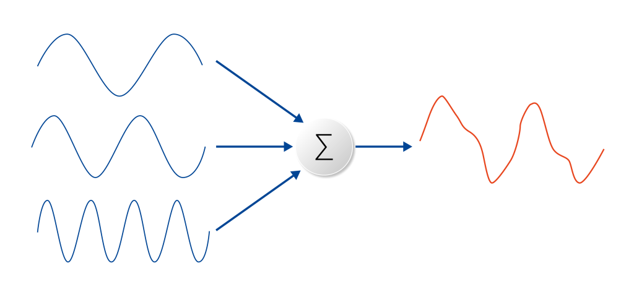
The Math Used (FFT)
Every sound we have ever heard is a mix of frequencies bundled together just like ingredients in a recipe.
We use a fast algorithm called FFT (Fast Fourier Transform) to ask the audio which frequencies are present and how much ? , it pulls mixed waves into separate identifiable tones, which have their set of combined proprieties which make it unique (amplitude, frequency, phase).
FFT is the improved algorithm deriving from the older DFT allowing us to turns months of computation into minutes in the fraction of the time, which is why processing 200-330GB of riverside data per week is even feasible.
Eulers formula is the math that has been around since the 18th century which makes all this possible, it can break down any sound wave (no matter how complex) into a combination of simple rotating cycles, the FFT essentially does that.

Slide 5
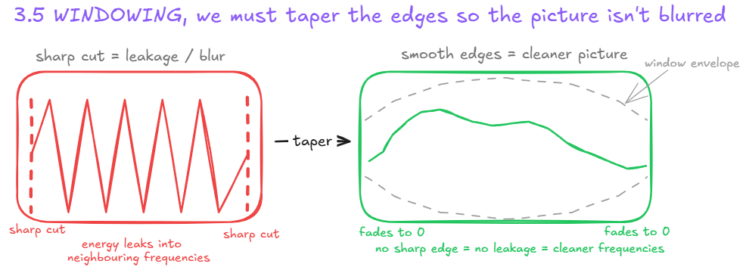
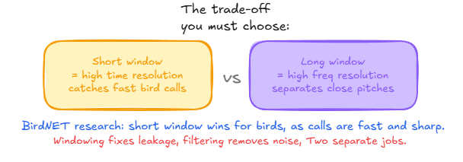
Why windowing is necessary?
To analyse long recordings, we must first cut it in shorter chunks, however cutting at sharp edges introduces a problem called spectral leakage, this is when energy from a frequency smears into its neighbours blurring the actual picture of the sound, potentially burying the faint call of other birds under a loud .
Windowing functions like Hann, Hamming or Blackman are used to taper the edges of each block smoothly, each making a slightly different trade-off between preserving frequency detail and supressing leakage, hence why choosing the right windowing function is important.
The window size we choose directly affect time and frequency resolutions (Trade off):
Short Window provides high time resolution meaning it can capture rapid, sharp bird calls clearly but with a coarser frequency.
Long Window provides high frequency resolution, meaning it can clearly separate 2 similar pitches but blurs fast changes in exchange.

Slide 6
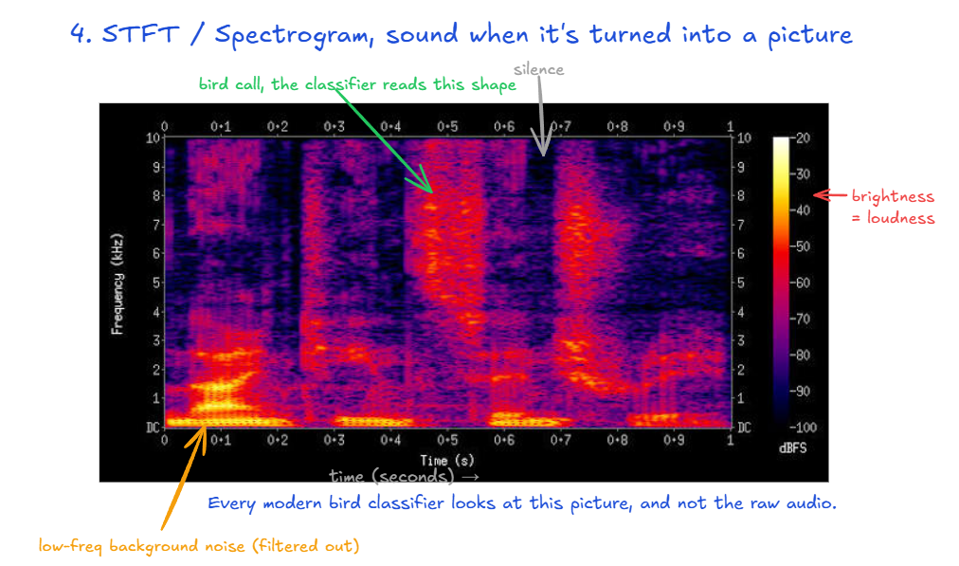
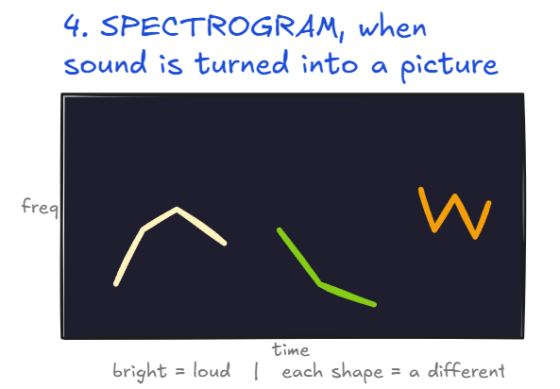
STFT & Spectrogram
The Spectrogram is a picture of the sound where time runs on the horizontal- axis, frequency (pitch) on vertical axis and the loudness of each frequency at each moment is represented by brightness.
The SFTF (Short-Time Fourier Transform) is exactly what produces this image by sliding the analysis window across the entire recording, taking an FFT at each step and layering them side by side.
Every modern bird classifier uses this image (spectrogram), rather than the raw audio file itself. Every step before this slide exists to produce the best spectrogram possible, while everything after exists to read/process it (The windowing step earlier directly shapes this image).
BirdNET's research reveals that short-window (high time resolution) works best for birds, as their calls are so rapid and sharp.

Slide 7
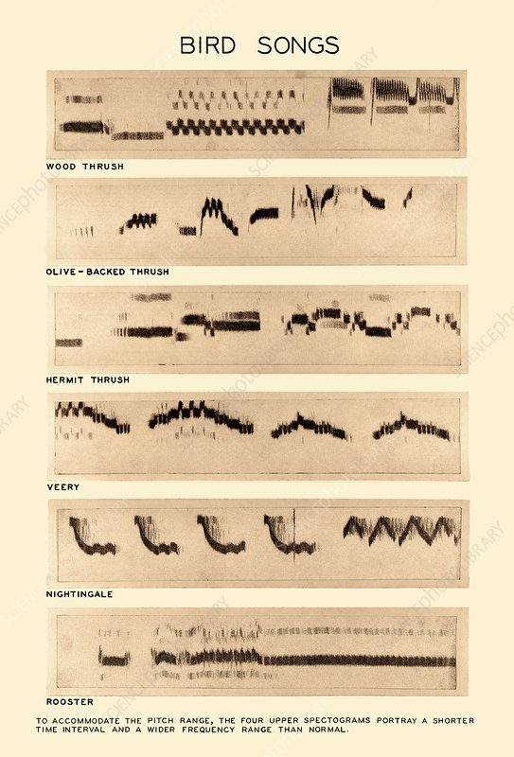
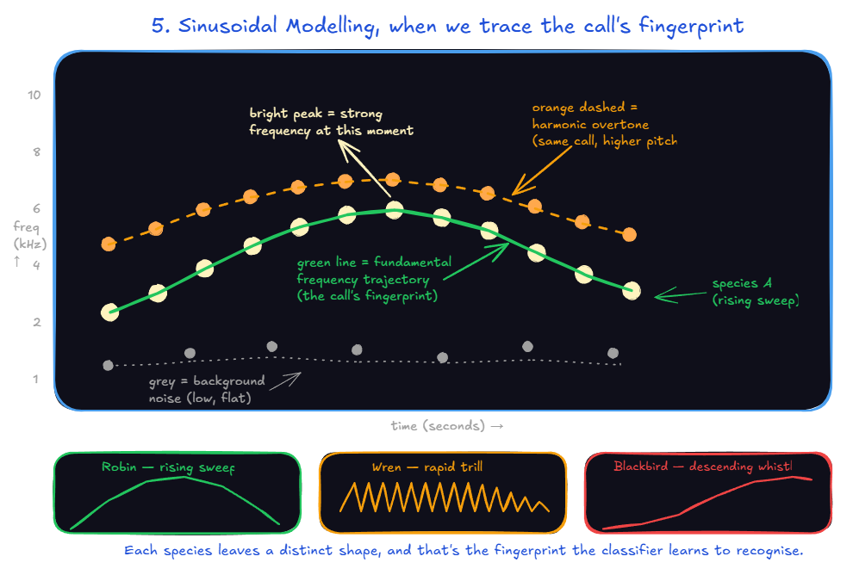
Sinusoidal Modelling
Sinusoidal modelling consists in find the brightest peaks of energy (strongest frequencies at each instant) and connect them overtime into trajectories.
Outlining these peaks makes it much simpler for human eyes and machines to visualise the individuality of a robin's call compared to a balckbird, as each have their own unique characteristically patterns (composed of descending whistles, rising sweeps, trills, and rising sweeps), a kind of biometric signature.

Slide 8
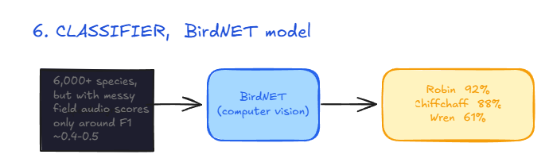
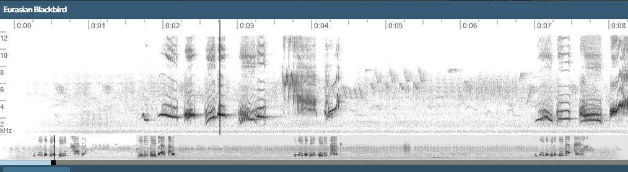
BirdNET Classifier
Once we have a clean picture (spectrogram), we can have the ML (machine learning) "birdwatcher" analyse it.
ML models like BirdNET don’t listen the audio itself but rather analyse the spectrogram images using computer vision techniques (same technology used for facial recognition), to predict which bird species are singing.
BirdNET treats spectrograms as monochrome image, and it can identify up to 6,500+ species simply by the shape of their sound.

Slide 9
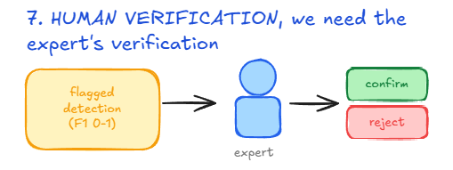
Why Machines Still Need Humans?
All the hard work is done by the automated pipeline (data sorting, the mathematical processes, making spectrograms and assigning confidence scores) , however this does not leave humans completely out of the equation.
We still need bird experts to review the results, confirm uncertain results, find missing species (which bird experts can provide the lack of ecological context as to why that is).
The pipeline's objective is to slim down the work experts must do, from process all the data and analyse to review and verify the detections made by the ML model, which is exactly what allows for more reliable and refined results at this extensive amount of data.
A European study across 194 sites found that messy data recorded in the wildlife rather than a clean lab recording dropped the model's performance to an F1 score below 0.5
An F1 score of 0.5 stands for when a model makes enough mistakes to miss bird calls and display false alarms; decent enough as a result but needing significant verification, while an F1 score of 0.8 on the other hand would stand for a solid result but still needing some verification.
The model has been shown to make errors even in our own pipeline, where it detected Engine 596 times and Siren 24 times in one instance, however those are clearly false positives as there's no such bird species and it is most likely referring to car engines and ambulance/police sirens, this being concrete proof that we need human verification no matter how good the model we are using may be.

Slide 10
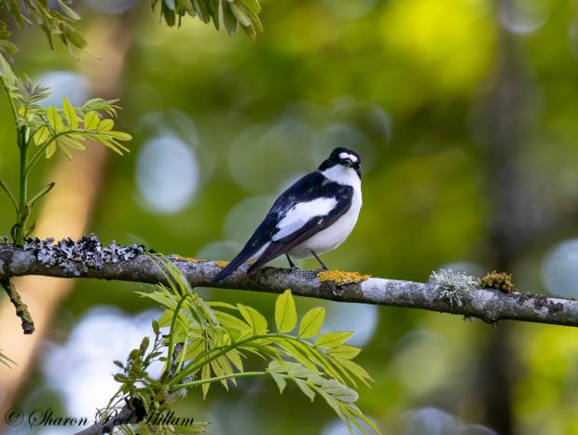
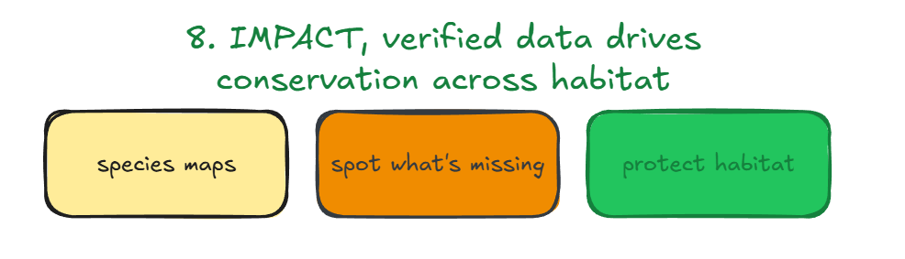
Impact & Next Steps
Once experts verify the detections they can be turned into powerful analytical insights, helping us understand which species are where and when across the riverside in a map format, highlighting how patterns change from the beginning to end (e.g. missing species, bird calls only at specific times, more human activity), these patterns are exactly what helps us predict ecological change (change in migration timing, noise pollution, habitat loss).
None of this is possible without the people in this room from experts to bird enthusiasts; the pipeline helps us understand what it heard, but only an expert can help us understand what that means and what things are missing and why. You have a role in this that no machine can replace, turning hours of riverside data into the crucial awareness needed to protect the birds living there.
As we continue to analyse these recordings, we may be able to document species that we never thought could be living in the riverside, every detection being verified by experts, alongside unexplainable missing species will lead to a better understanding of how to best protect the riverside.

